Slide 1
Apply to Study in Rome – Semester 1, 2027
Australian Catholic University
July 2026

Slide 2

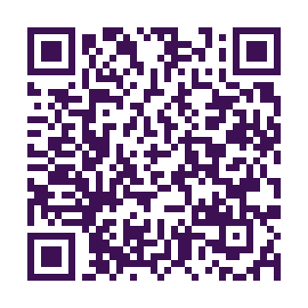
Apply to Study in Rome – Semester 1, 2027
Study in Rome
Turn your next semester into the experience of a lifetime.
Study at ACU’s dedicated Rome campus
Complete units towards your degree in intensive blocks
(focus + flexibility)
Travel across Europe between classes
Gain global experience that sets you apart
Financial support available
Places are limited. Submit your application by 31 July 2026.
For enquiries, contact globallearning.outbound@acu.edu.au

