Slide 1
CAMPUS CONVERSATIONS
Corporate Services May / June 2014 Dr Stephen Weller Chief Operating Officer & Deputy Vice-Chancellor

Slide 2
Overview
Corporate Services – Who are we?
Looking Back and Looking Forward
Shared Services Review Project and the Services Matter Framework
Federal Budget
Questions, comments, suggestions

Slide 4
Looking Back
Futures Blueprint
Enterprise Agreement
Budget Model Review
ICT Advisory Committee
Infrastructure Plan
Adelaide Campus

Slide 5
Looking Forward
MER Review and Properties Review
Installation of Chancellor
Student Central Concept Plan
Retail, Parking and Procurement Strategies
Comms Policy and Social Media Policy
2015-2020 Strategic Plan

Slide 6
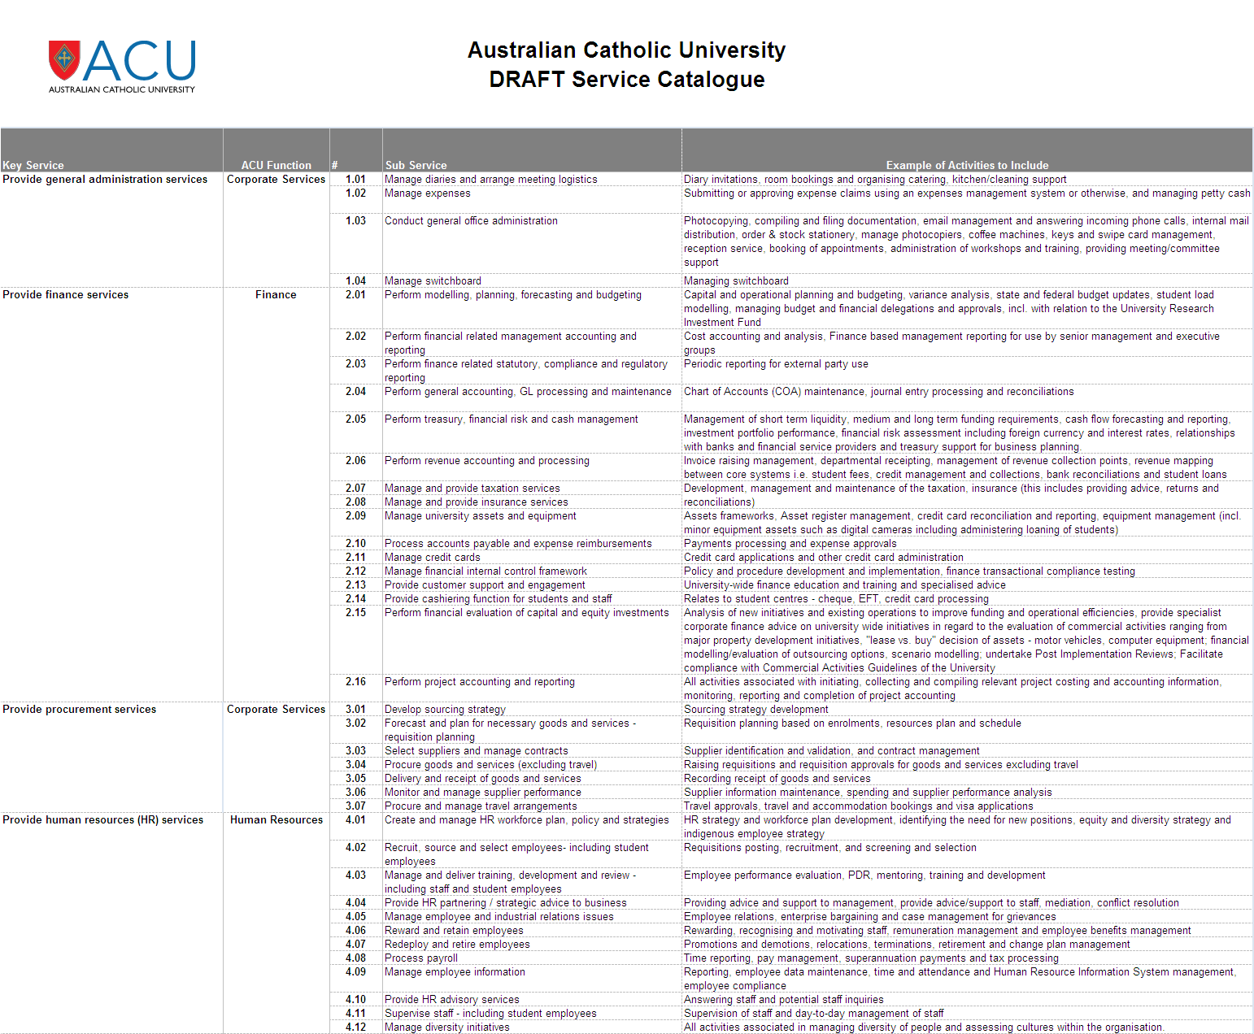
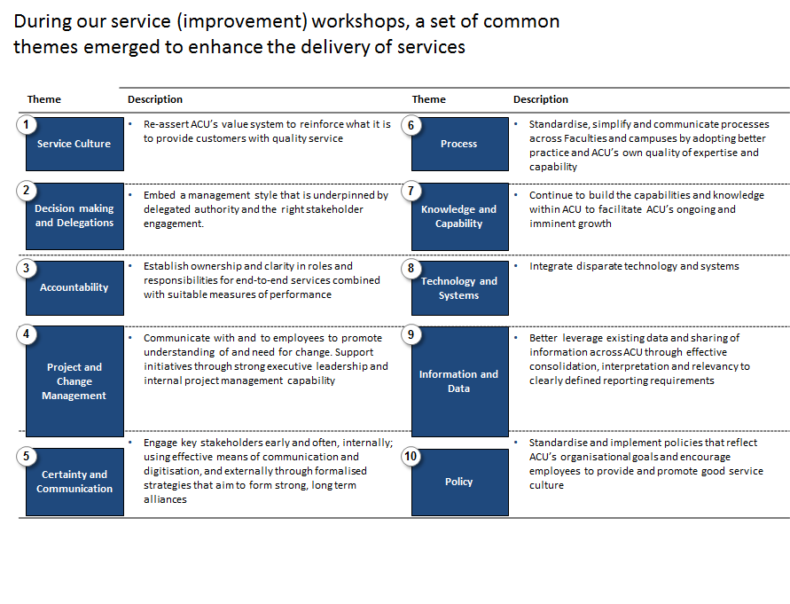
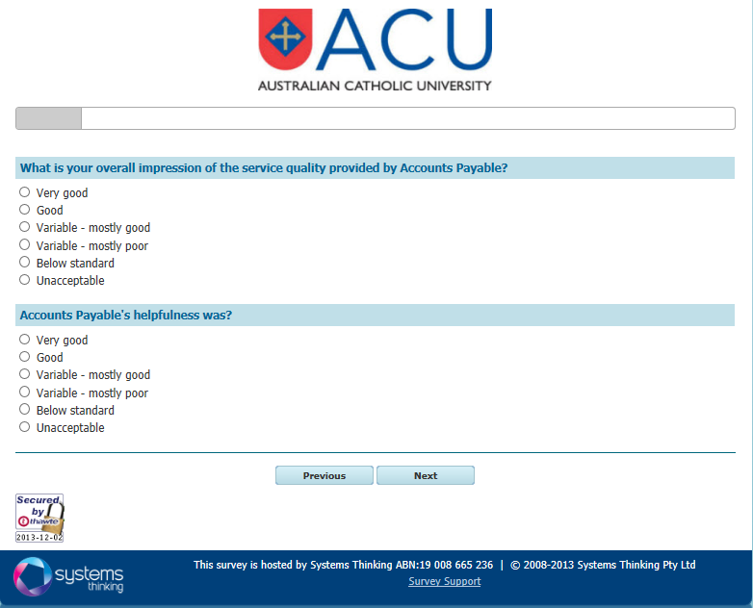
Shared Services Review & Service Matters Framework
Our Approach
1
Service Catalogue
2
Activity
Review
Service
Review
Staff
Survey
Operating
Framework
3
4
5
Key activity
Develop an ACU Service Catalogue
Identify and analyse quantified effort across the support services and draw key observations.
Identify improvement opportunities based on emerging themes.
Conduct a staff survey to measure satisfaction with service quality (obtain base-line service metrics data)
Develop a set of operating framework options and associated high level recommendations
Outputs
Operating Framework Options

Slide 7
Measuring Service Delivery
Source: EY Activity reviews, interviews and analysis

Slide 8
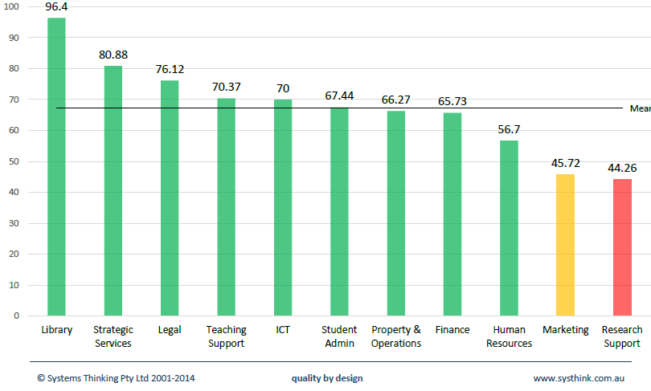
Measuring Service Quality
Overall Satisfaction – All Staff (By Service Category) – “Service Matters” Survey

Slide 9
Next Steps
SERVICE PRINCIPLES
an agreed ‘way of operating’ that is aligned with ACU’s values
SERVICE MODEL
defines accountability for service delivery
SERVICE CATALOGUE
a comprehensive list of ACU professional services
SERVICE IMPROVEMENT PROGRAM
based on feedback from workshops, survey, Directors
SERVICE LEADS
define and deliver the service in collaboration with other Service Leads, Faculties/Institutes, Directorates and Campuses.
Notes:
be next steps and indicate service principles, service catalogue, service delivery mode, service improvement program and service leads. Under service leads list all the ones that relate to Corporate Services.

Slide 10
Service Leads – COO Portfolio
Service Category | Service Lead
Policy & Strategy (Corporate) | COO
Student & Academic Administrative Services | Student Administration
Finance & Procurement | Finance
Human Resources & WHS Management | HR
Property & Operations Management | Properties
Marketing, Communication & External Relations | MER
Information & Communication Technology | IT
Governance & Legal | Governance
ACU Strategy, Policy, Quality & Compliance Framework Management | OPSM
General Administrative Services | COO

Slide 11
Federal Budget
Commission of Audit
Kemp / Norton Review
Retention of Demand Driven Model
Competition from private providers
Increased student contributions
Complete fee deregulation

Slide 12
Questions?
Comments?
Suggestions?

