Slide 1
CAMPUS CONVERSATIONS Corporate Services November 2013 Dr Stephen Weller Chief Operating Officer & Deputy Vice-Chancellor

Slide 2
ABOUT CAMPUS CONVERSATIONS
Corporate Services – Who are we?
Futures Project and Shared Services
ACU Service Delivery & Enablers
Questions, comments, suggestions

Slide 4
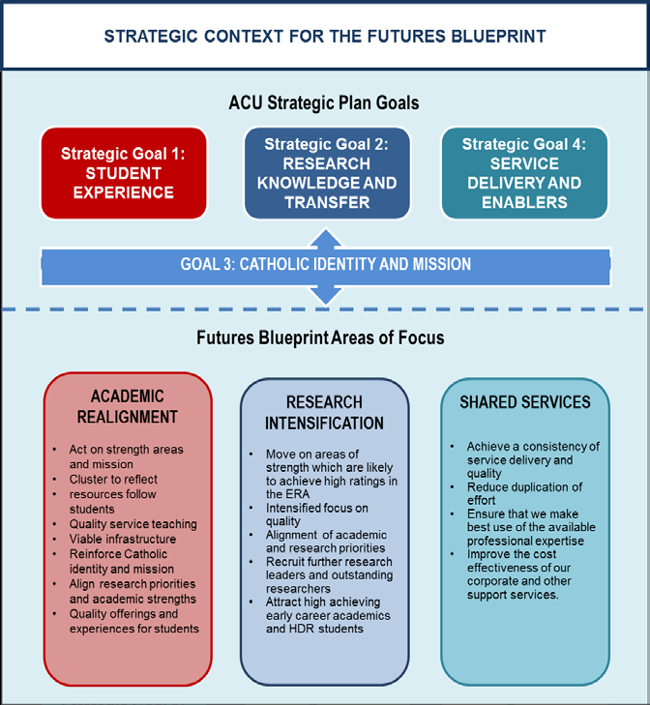

Slide 5
SHARED SERVICES - PROJECT OVERVIEW
Stage 1: Initiation
Stage 2: Diagnose
Stage 3: Design
Stage 4: Implement
Stage 5: Review
Establish project team and project governance.
Identify key stakeholders.
Confirm scope and deliverables.
Gain insights from other institutions.
Implement initial shared services delivery:
Faculty management accounting and marketing functions.
HR and IT Relationship Management.
Analysis of "as is" operating model and what needs changing.
Develop service metric framework.
Informed by external benchmarks.
Stakeholder consultation on current service performance.
Build ACU current service catalogue.
Develop options for the future "to be" operating model and service catalogue.
Consultation and assessment of options.
Confirm preferred service model.
Identify key changes required to move to new service model.
Revise systems, policies, structures and processes to support new model, including formal change management.
Design accountability and reporting matrices.
Develop roadmap for implementation, including transition arrangements to ensure business continuity.
Execute plan.
Implement strategies to support transitional arrangements and business continuity.
Develop communication and engagement strategy and tools.
Build capabilities.
Define partnership agreements, service charters/schedules.
Monitor and assess service delivery framework.
Consultation during implementation.
Post implementation consultation and review.
Performance assessment and refinement of service delivery framework.
Embed continuous improvement processes and culture.
Update ACU service catalogue.
Assessment of service culture impact.
Ongoing consultation with stakeholders and Project Steering Group
July – Oct 2013
Oct 2013 – Feb 2014
Mar – May 2014
Oct – Nov 2014
June – Sep 2014

Slide 6
CORPORATE SERVICES Service Delivery & Enablers
KEY RESULT AREA | STRATEGY
Strategic Approach | Development of Strategic Plan 2015 - 2020 Finalisation of Mission Based Compact Admissions and Post-Graduate Strategy Course & Student Policies Audit
2. Workforce Involvement, Profile & Productivity | Enterprise Bargaining Negotiations Developing and updating Workforce Plans Review of Capabilities Development Strategy
3. Financial Performance | Budget Model Review Strategic Procurement Review Business Performance Office & Process Review

Slide 7
CORPORATE SERVICES Service Delivery & Enablers
KEY RESULT AREA | STRATEGY
4. Infrastructure | Campus Master Plans Infrastructure Plan 2014 – 2023
5. Sustainability | Audit of Resource Efficiency – energy, water and waste Upgrade of video conferencing capabilities
6. Service Delivery | Shared Services Review Course Progression Project Formation of Governance Directorate Review of ICT governance
7. External Relations | Engagement Strategy Student Recruitment & External Relations Directorate

Slide 8
Questions?
Comments?
Suggestions?

