Slide 1


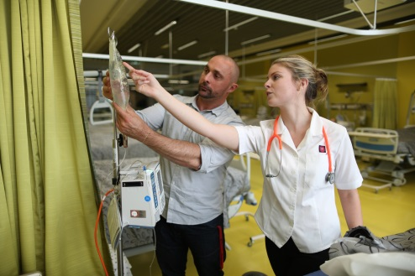
Inherent Requirements:
Creating a Shared Understanding
Associate Professor Amanda Johnson
State Head of School of Nursing, Midwifery and Paramedicine NSW/ACT
Australian Catholic University
Adjunct Associate Professor Western Sydney University
Carolyn Toonen
Manager Disability Services
Notes:
Welcome to this workshop on Inherent Requirements. Introduce presenters –
I know a lot of you will have questions and if you could keep them till the end we will be happy to answer them all.
Importantly IR’s are an emerging field of practice .
Students with disabilities have the same desire as any other student to pursue learning and to enhance their future employment opportunities but are underrepresented in the higher education sector(Bradley, Noonan, Nugent & Scales, 2008). Their access and participation is often impeded and provides challenges for all.
What is necessary is the provision of institutional policy and processes, to support access and participation by students to achieve success (Nunan et al, 2000). It is our experience that the use of an embedded IR strategy is the means to achieve this success.
Formally articulating IRs, their public dissemination and generating an evidence base forms the basis of best practice. The strategy enables potential and continuing students, academics and disability services staff a means by which to systemically apply IRs and monitor reasonable adjustments. This has the potential to reduce the challenges for the student, institution, public and wider profession while maintaining the academic integrity of the course and complying with legislative requirements.
* Whole of institution response

Slide 2
Purpose
To:
Create a shared understanding of inherent requirements among staff to facilitate best practice in managing students.
A

Slide 3
Key Areas
Inherent Requirements: What are they? and What they are not?
Context
Key Definitions
Students with Disabilities – ACU Snapshot
Reasonable Adjustments
Conceptualisation of IRs - Why and How they were developed
Benefits – to Academics, Students and Disability Advisers
Implementation of Pilot Project at ACU
Questions
A

Slide 4
Acknowledgements
Western Sydney University (UWS)
Inherent Requirement of Nurse Education [IRoNE] project
University of Western Sydney Inherent Requirement Strategy
Lead: Associate Professor Amanda Johnson Ms Kirrilee Phillips (Project Officer) Mr Trevor Allan | Associate Professor Cecily Hengstberger-Sims Ms Mary Goldsmith Ms Cathy Dickson Ms Toni Azzopardi
Lead: Associate Professor Amanda Johnson Ms Kirrilee Phillips (Project Officer) Disability Services Staff
A

Slide 5
What Inherent Requirements Are?
A student enabling support strategy –supporting student success and retention.
A tool to facilitate communication between student/disability advisor & academic – applies to all and is based on ability, not disability.
Promotes transparent and consistent decision making
A
Notes:
So why do we have inherent requirements?
1. Legislation
In 2009 the Disability Discrimination and other Human Rights Legislation Amendment Act No. 70 introduced several amendments to the DDA which significantly increased the risks associated with not having clear, comprehensive inherent requirements articulated for courses (Australian Government Comlaw, 2008). Three of those changes, in particular, impact on the risk for education providers.
The first change includes behaviour caused by a disability as part of the definition of a disability. While it does not remove the right to manage behaviour that impacts adversely on the health, safety, or wellbeing of the student or others, it now emphasises the need to have a clear justification of the reasons why particular behaviours may not be able to be accepted.
Secondly, the amendments place an obligation on education providers to take proactive steps to prevent discrimination occurring. Education providers can no longer just be reactive, but must try to identify potential discriminatory issues and take steps to prevent them occurring.
Finally, the burden of proof has shifted from the person making the complaint to the person or institution the complaint is about. Instead of the student having to prove that discrimination occurred, the educational institution has to prove that it didn’t. That is much harder to prove and requires evidence, such as records, notes, and policies, which substantiate the educational institution’s defence against a claim of discrimination. Without such evidence, the educational institution is at risk of an adverse finding because of the much higher burden of proof now required (Australian Government Comlaw, 2009).
Disability advisers deal with inherent requirements all the time but it is often difficult and time-consuming to determine what they are because they haven’t really been articulated by the School. Having them articulated upfront means that it is a much clearer, more timely and more rigorous process in determining what adjustments are appropriate for students with disabilities in particular courses.
It also prevents indirectly discriminating against students with disabilities because we can let them know what will be required of them as part of the course before they enroll in courses so that they can make informed decisions about whether or not to enroll. If we don’t do this, we are potentially discriminating against a person who enrolls in a course and spends time and money on something that they were never going to be able to complete.
2. Inclusiveness
Applicable to all students
The international agenda of inclusiveness in university education necessitates the re-design of curriculum. This is about engaging all and minimising barriers students face in accessing. Inclusiveness constitutes six practical principles. The first of these relates to the articulation and dissemination of course inherent requirement statements prior to enrolment. This principle supports all students having greater access and participation to learning opportunities.
Provides the students with the opportunity to disclose up front and begin conversation and work through possible solutions for their course progression.
* If we are asked: The other five principles
further inform the development of curriculum at different
phases of the design process.
3.Risk Management
Legislative : Need for compliance and informed decision making
Systematic and transparent process which provides an audit trail of the decisions taken
Process which enables best practice and consistency of application of the Reasonable Adjustments
Gate Keeping
It is also important to emphasis that it is unlawful under the Disability Discrimination Act (DDA) for a university to refuse to admit a person to a course or refuse progress in a course on the basis that the person is unlikely or unable to gain work because of their disability. We can only be concerned with the inherent requirements of the courses we offer.

Slide 6
What Inherent Requirements are Not ?
Not a Gate Keeping mechanism
Not a means by which to Exclude
A
Notes:
So why do we have inherent requirements?
1. Legislation
In 2009 the Disability Discrimination and other Human Rights Legislation Amendment Act No. 70 introduced several amendments to the DDA which significantly increased the risks associated with not having clear, comprehensive inherent requirements articulated for courses (Australian Government Comlaw, 2008). Three of those changes, in particular, impact on the risk for education providers.
The first change includes behaviour caused by a disability as part of the definition of a disability. While it does not remove the right to manage behaviour that impacts adversely on the health, safety, or wellbeing of the student or others, it now emphasises the need to have a clear justification of the reasons why particular behaviours may not be able to be accepted.
Secondly, the amendments place an obligation on education providers to take proactive steps to prevent discrimination occurring. Education providers can no longer just be reactive, but must try to identify potential discriminatory issues and take steps to prevent them occurring.
Finally, the burden of proof has shifted from the person making the complaint to the person or institution the complaint is about. Instead of the student having to prove that discrimination occurred, the educational institution has to prove that it didn’t. That is much harder to prove and requires evidence, such as records, notes, and policies, which substantiate the educational institution’s defence against a claim of discrimination. Without such evidence, the educational institution is at risk of an adverse finding because of the much higher burden of proof now required (Australian Government Comlaw, 2009).
Disability advisers deal with inherent requirements all the time but it is often difficult and time-consuming to determine what they are because they haven’t really been articulated by the School. Having them articulated upfront means that it is a much clearer, more timely and more rigorous process in determining what adjustments are appropriate for students with disabilities in particular courses.
It also prevents indirectly discriminating against students with disabilities because we can let them know what will be required of them as part of the course before they enroll in courses so that they can make informed decisions about whether or not to enroll. If we don’t do this, we are potentially discriminating against a person who enrolls in a course and spends time and money on something that they were never going to be able to complete.
2. Inclusiveness
Applicable to all students
The international agenda of inclusiveness in university education necessitates the re-design of curriculum. This is about engaging all and minimising barriers students face in accessing. Inclusiveness constitutes six practical principles. The first of these relates to the articulation and dissemination of course inherent requirement statements prior to enrolment. This principle supports all students having greater access and participation to learning opportunities.
Provides the students with the opportunity to disclose up front and begin conversation and work through possible solutions for their course progression.
* If we are asked: The other five principles
further inform the development of curriculum at different
phases of the design process.
3.Risk Management
Legislative : Need for compliance and informed decision making
Systematic and transparent process which provides an audit trail of the decisions taken
Process which enables best practice and consistency of application of the Reasonable Adjustments
Gate Keeping
It is also important to emphasis that it is unlawful under the Disability Discrimination Act (DDA) for a university to refuse to admit a person to a course or refuse progress in a course on the basis that the person is unlikely or unable to gain work because of their disability. We can only be concerned with the inherent requirements of the courses we offer.

Slide 7
Competing Tensions in Higher Education
Legislation
Disability Discrimination Act (DDA) 1992 [amendment 2009]
Disability Education Standards (The Standards) 2005
Review of the Disability Education Standards (2012)
Widening Participation
Inclusive Education Practice
Institutional Risk Management
A
Notes:
So why do we have inherent requirements?
1. Legislation
In 2009 the Disability Discrimination and other Human Rights Legislation Amendment Act No. 70 introduced several amendments to the DDA which significantly increased the risks associated with not having clear, comprehensive inherent requirements articulated for courses (Australian Government Comlaw, 2008). Three of those changes, in particular, impact on the risk for education providers.
The first change includes behaviour caused by a disability as part of the definition of a disability. While it does not remove the right to manage behaviour that impacts adversely on the health, safety, or wellbeing of the student or others, it now emphasises the need to have a clear justification of the reasons why particular behaviours may not be able to be accepted.
Secondly, the amendments place an obligation on education providers to take proactive steps to prevent discrimination occurring. Education providers can no longer just be reactive, but must try to identify potential discriminatory issues and take steps to prevent them occurring.
Finally, the burden of proof has shifted from the person making the complaint to the person or institution the complaint is about. Instead of the student having to prove that discrimination occurred, the educational institution has to prove that it didn’t. That is much harder to prove and requires evidence, such as records, notes, and policies, which substantiate the educational institution’s defence against a claim of discrimination. Without such evidence, the educational institution is at risk of an adverse finding because of the much higher burden of proof now required (Australian Government Comlaw, 2009).
Disability advisers deal with inherent requirements all the time but it is often difficult and time-consuming to determine what they are because they haven’t really been articulated by the School. Having them articulated upfront means that it is a much clearer, more timely and more rigorous process in determining what adjustments are appropriate for students with disabilities in particular courses.
It also prevents indirectly discriminating against students with disabilities because we can let them know what will be required of them as part of the course before they enroll in courses so that they can make informed decisions about whether or not to enroll. If we don’t do this, we are potentially discriminating against a person who enrolls in a course and spends time and money on something that they were never going to be able to complete.
2. Inclusiveness
Applicable to all students
The international agenda of inclusiveness in university education necessitates the re-design of curriculum. This is about engaging all and minimising barriers students face in accessing. Inclusiveness constitutes six practical principles. The first of these relates to the articulation and dissemination of course inherent requirement statements prior to enrolment. This principle supports all students having greater access and participation to learning opportunities.
Provides the students with the opportunity to disclose up front and begin conversation and work through possible solutions for their course progression.
* If we are asked: The other five principles
further inform the development of curriculum at different
phases of the design process.
3.Risk Management
Legislative : Need for compliance and informed decision making
Systematic and transparent process which provides an audit trail of the decisions taken
Process which enables best practice and consistency of application of the Reasonable Adjustments
Gate Keeping
It is also important to emphasis that it is unlawful under the Disability Discrimination Act (DDA) for a university to refuse to admit a person to a course or refuse progress in a course on the basis that the person is unlikely or unable to gain work because of their disability. We can only be concerned with the inherent requirements of the courses we offer.

Slide 8
Key Definitions
Disability
Inherent Requirements
Reasonable Adjustments
Notes:
Key Definitions
Being aware of what constitutes a disability; IRs and RA. This creates a shared understanding across the sector and among disciplines.

Slide 9
Disability
According to the legislation disability in relation to a person means:
total or partial loss of the person’s bodily or mental functions; or
total or partial loss of a part of the body; or
the presence in the body of organisms causing disease or illness; or
the presence in the body of organisms capable of causing disease or illness; or
the malfunction, malformation or disfigurement of a part of the person’s body;
a disorder or malfunction that results in the person learning differently from a person without the disorder or malfunction; or
a disorder, illness or disease that affects a person’s thought processes, perception of reality, emotions or judgment or that results in disturbed behaviour; and includes a disability that:
presently exists; or
previously existed but no longer exists; or
may exist in the future; or
is imputed to a person.
(Australian Government Comlaw, 2010)
C
Notes:
The Disability Discrimination Act [DDA] 1992 as amended in 2009 (Australian Government Comlaw, 2010) informs providers of higher education and others, with clear direction as to what constitutes a person with disability.
To avoid doubt, a disability that is otherwise covered by this definition includes behaviour that is a symptom or manifestation of the disability.
It is also important to note that the impact of a disability varies among individuals, cannot be assumed and varies with a particular disability and across disability groups. Sometimes people experience multiple disabilities.

Slide 10
Disability Standards for Education
For more information on the Disability Standards for Education which covers:
  Making Reasonable Adjustments
  Standards for Enrolment
  Standards for Participation
  Standards for Curriculum Development, Accreditation & Delivery
  Standards for Student Support
  Standards for Harassment & Victimisation
Complete the DSE 2005 online training module on LEO
http://leo.acu.edu.au/course/view.php?id=7041
C
Notes:
To understand the requirements of universities as stipulated under the Disability Standards of Education 2005, there are 8 online modules available on LEO covering the 5 domains mentioned on this slide. They are self paced modules. The modules will be reconfigured for 2016 and staff will have 12 months to complete the training. Those who complete the modules will have this training noted on their staff files via HR.

Slide 11
2015 ACU Snapshot -
Students with Disability
1212 students with EIPs
561new student EIPS in 2015
3% vision impairments
2% hearing impairments
11% Learning disabilities
4% mobility disabilities
36% medical
38% mental health etc.
4% Carers
C

Slide 12
Inherent Requirements
Are the fundamental components of a course or unit, that are essential to demonstrate the capabilities, knowledge and skills to achieve the core learning outcomes of the course or unit, while preserving the academic integrity of the university’s learning, assessment and accreditation processes. (Note: making a requirement compulsory does not necessarily make it an Inherent Requirement)
(UWS Inherent Requirements Working Party, 2010)
C
Notes:
Informed literature/experience
When we started articulating the IR’s for the BN at UWS there was no agreed definition either internationally or in Australia. To facilitate the project's work the UWS Academic Senate Education Committee determined an agreed definition for the use across the university.
Which is :
Inherent requirements are the fundamental components of the course or unit that are essential to demonstrate the capabilities knowledge and skills to achieve the core learning outcomes of the course or unit, while preserving the academic integrity of the University’s learning, assessment and accreditation processes. (Note: making a requirement compulsory does not make it an inherent requirement.)

Slide 13
Reasonable Adjustments
An adjustment is a measure or action taken to assist a student with a disability to participate in education and training on the same basis as other students.
Reasonable in this context refers to making adjustments which maintain the academic integrity of the course. (3.4 DSE 2005)
C
Notes:
Reasonable Adjustments
The Disability Discrimination Act (DDA) through the Disability Standards for Education requires institutions to take reasonable steps to enable the student with a disability to participate in education on the same basis as a student without a disability.
An adjustment is a measure or action taken to assist a student with a disability to participate in education and training on the same basis as other students. Examples of adjustments include: provision of a Note taker or Sign Language Interpreter; provision of adaptive equipment / furniture or assistive technology
An adjustment is reasonable if it balances the interests of all parties affected.
Making changes to ensure equal opportunity for people with a disability is commonly referred to as "reasonable adjustment"
Accommodation
Adjustment

Slide 14
How are Reasonable
Adjustments determined
Comprehensive assessment in consultation with the student.
Informed by medical documentation from an appropriately qualified practitioner
Should not impact upon the academic integrity of the course of study i.e. not compromise the learning outcomes of a unit.
Articulated through an Education Inclusion Plan (EIP)
Continued dialogue, documentation and monitoring
C
Notes:
How are reasonable adjustments determined?
We find this is a question that we get asked a lot from academics at our IR Workshops.
The Disability Service undertakes a comprehensive assessment process with each student in order to determine the reasonable adjustments appropriate to the individual. The assessment process takes into consideration the nature of the student’s medical condition, the individual’s context and the requirements of the Course of study.
Reasonable adjustments are always underpinned by medical documentation from the student’s treating professional.
Reasonable adjustments should not impact upon the academic integrity of the course of study.
Reasonable adjustments are articulated through the Academic Integration Plan (AIP)
This involves continued dialogue, documentation and monitoring with the students, academics , clinical facilitators and disability staff

Slide 15
About Disability Services
ACU is an adult learning environment. Consistent with the development of graduate attributes students are encouraged to communicate directly with their lecturers regarding their learning needs.
Students are required to provide their lecturer with their EIP if they need adjustments for that unit.
Lecturers can identify students with EIPs on their class lists.
Whilst Disability Advisers can recommend reasonable adjustments for learning and assessment, reasonable adjustments for practicums are more complex and require an understanding of inherent requirements and the practicum context.
C

Slide 16

Conceptualisation of Inherent Requirements at UWS:
Inherent Requirement of Nurse Education
IRoNE project
A
Notes:
Conceptualisation of Inherent Requirements
Why did we feel the need to establish the IRONE project?
Two Triggers
Clinical – issues on placement was the impetus/ challenges in clinical setting
Gaps in practice/ literature
UWS is a large outer metropolitan university with over 40,000 students. We have 6 campuses across Greater Western Sydney.
2712 of these are undergraduate nursing students, making UWS’s SoNM one of the largest provider of undergraduate nursing education in Australia. Of these 3.2% self report with a disability. In the last 5 years self reporting has increased and is expected to rise further.
National average = 4.6%
*Since 2009 23% increase in self disclosure at UWS
* Increase prevalence of mental illness
For staff at the University of Western Sydney’s (UWS) School of Nursing & Midwifery (SoNM) and the Disability services determining how best to systematically support students with disability from both a legislative and risk management perspective was paramount. The result was the Inherent Requirements of Nursing Education (IRONE) project in 2010, a collaborative partnership between the SoNM, and the Student Equity, Welfare and Disability Services. The membership consisted of academics with expertise in curriculum design; clinical and simulation learning and disability.
The project’s purpose was to identify the inherent requirements of the UWS’s undergraduate nursing program and construct a series of statements which articulated the program’s inherency. We engaged in a curriculum mapping exercise, unit by unit within the course.
A framework to facilitate their expression was also developed which illustrates the justification and characteristics of the reasonable adjustments within the framework. These components were deemed critical to the inherency and are the distinguishing feature that separates this work from previous attempts to make explicit inherent requirements. Inclusion of these components provides a more substantive position of defence and communicates a shared understanding of what is inherent.
Discuss our experience:
Student with Cochlear Implant- Communication Verbal + Auditory
Student with MVA- sustainability performance

Slide 17
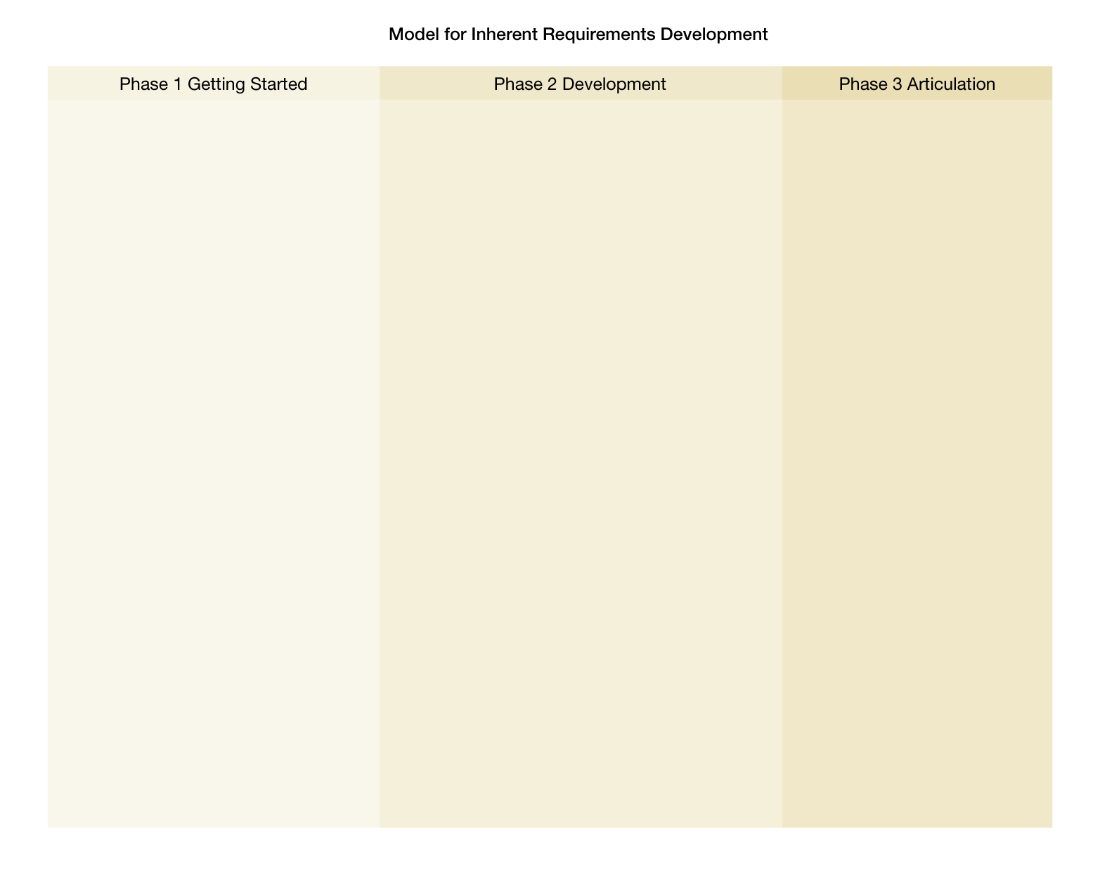
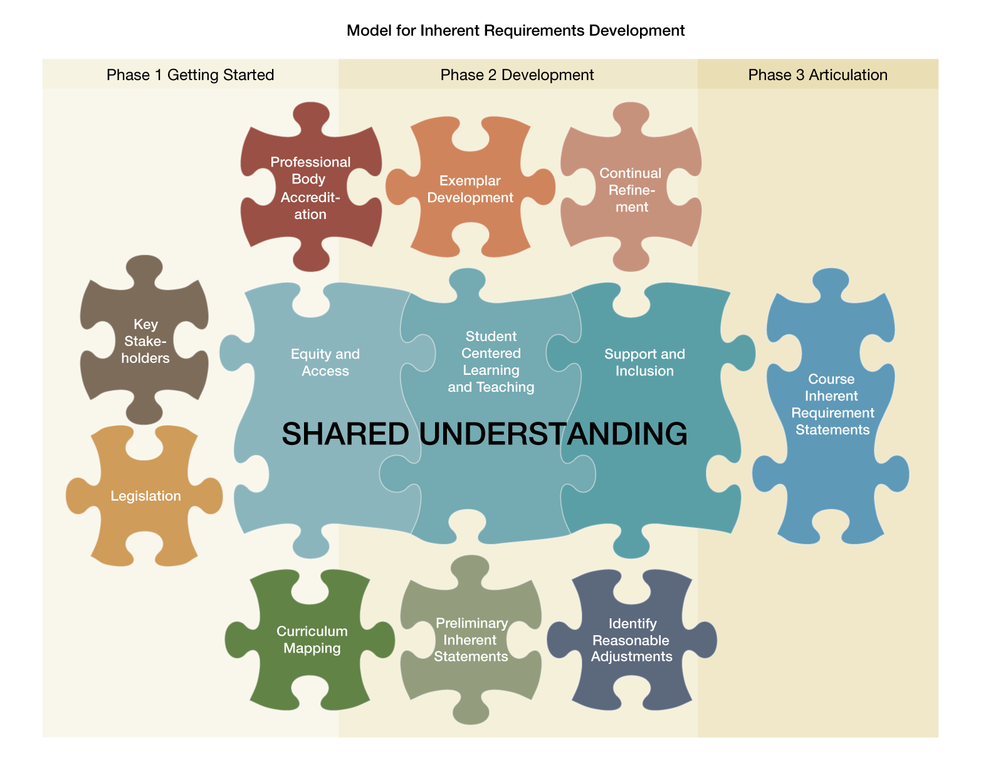

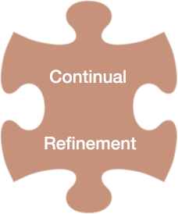









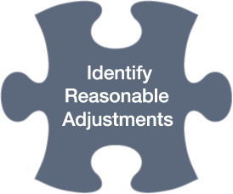
Process
*Reasonable Adjustments
** Inherent Requirements
A
Notes:
Concurrent to developing the statements the team began to realise the complexity of the process we were engaged in and we identified the key aspects. The team considered how best we could visually present this to others so as to create an understanding of what underpins the IR statements development and so have produced a Model for Development.
Process:
Phase 1 Getting Started
Key Stake holders
The first step was to gather a small committee of key stake holders covering academic, clinical, management and disability areas. Qualities of working party should be: expertise field and clinical placement, disability contact, curriculum expert, driver/champion, commitment and a position title to make decisions Contact needs to be made with Librarian /preliminary literature search using key words Higher education, own discipline( nursing), disability. Canvas of other universities was made and .appointment of a project officer commenced.
Legislation
Understanding of the legislative background and an understanding of inherent requirements is required and a deeper understanding of disability practice and the concept of reasonable adjustments and what these mean for the discipline of nursing.
Curriculum Mapping
Reviewing a student assessment for adjustment to facilitate clinical was the starting point to formulate a preliminary draft. Undergraduate course document was cross referenced to identify the inherent requirements of the course and the structure of how to articulate them.
Don’t work in isolation of the curriculum.
Professional Body Accreditation
This information had to be placed in the context of requirements of the NMBA and other professional requirements. The course offered by SoNM are accredited by the NMBA and at all times, SoNM staff are obliged to ensure that courses, units and practices comply with NMBA requirements in order to maintain accreditation.
Phase 2 Development
Preliminary Inherent Statements
Preliminary statements were developed and multiple meetings were conducted to fine tune statements.
Exemplar Development
Exemplars to contextualising an increased understanding, was the key to teasing out inherent requirement statements. Exemplars have been mostly based on one academic example and one clinical example. There are some statements that we have two clinical exemplars because reasonable adjustments can be made to the theory component of the course on campus.
Identify Reasonable Adjustments.
Reasonable adjustments where identified and explored and discussions made as what was the nature of the reasonable adjustment necessary to meet the inherent requirement.
Continual Refinement
Continual refinement of inherent requirement statements was made to see if they were robust against the inherent requirement definition. Multiple meetings with team were conducted to discuss and understand the notion of inherent and the application to nursing. Extensive process of refinement of not only the requirements, but also the structure and the approach.
Phase 3 Articulation
Shared Understanding
Shared Understanding was critical to the whole process. Equity and Access, Student Centred Learning and Teaching and Support and Inclusion all central to this process.
Course Inherent Requirement Statements
Inherent requirement statements to provide clear parameters for the determination of reasonable adjustments to enable admission and progression of students with disabilities in the bachelor of nursing program.
Combinations of all aspects of the model are required to formulate Course Inherent Requirement Statements which will facilitate informed decision making of potential and current undergraduate students.

Slide 18
UWS Framework
 | Descriptor
1 | Introductory statement
2 | Describes the requirement
3 | Provides the justification for why it is inherent
4 | Level
5 | Provides exemplars to assist with understanding from both an academic course and clinical perspective, when necessary
A
Notes:
Inherent Requirements Framework
The conceptualisation of the inherent requirement statements were framed to consist of five levels.
This framework assisted in communicating the understanding course inherent requirements. The literature reviewed also identified a failure to provide justification of the inherency and or consideration of the reasonable adjustments. This was considered to be a limitation in achieving a shared understanding of what is inherent in a BN course.
The framework helped to make explicit the difference between what is often deemed a compulsory and an inherent course requirement. The framework has also assisted in the determination of reasonable adjustments concurrent to formulating the statements which will aid implementation at the course / unit level in discussions held between students, disability advisors and academic staff.
Level 1: Statement which describes the inherency
Level 2: Behaviours demonstrated
Level 3: Statement or statements which express the justification
Level 4: describes the characteristics of the RAs required
Level 5: exemplars to aid understanding – theoretical and clinical perspective usually

Slide 19
Example: UWS BN IR
Communication: Verbal
Levels | Inherent Requirement Statements
1 | Effective verbal communication, in English, is an essential requirement to provide safe delivery of care.
2 | Student Demonstrates: Sensitivity to individual and/or cultural differences The ability to understand and respond to verbal communication accurately, appropriately and in a timely manner The ability to provide clear instructions in the context of the situation Timely clear feedback and reporting
3 | Justification of inherent requirement: Communicating in a way that displays respect and empathy to others and develops trusting relationships Communication may be restricted to verbal because of physical limitations of the individual (e.g. injury, disease or congenital conditions) Speed and interactivity of communication may be critical for individual safety or treatment Timely, accurate and effective delivery of instructions is critical to individual safety, treatment and management
4 | Adjustments for verbal communication need to address effectiveness, speed, clarity and accuracy issues to ensure safety and appropriate care. Adjustments specific to the individual can be discussed with the campus Disability Advisor.
5 | Exemplars: Participating in tutorial discussions, simulation and clinical discussions Responding appropriately to a care request in the clinical environment
A
Notes:
KP
Needs to be updated post meeting next week
What does the UWS IR’s look like?
This is an example of our BN Communication : Verbal requirement.
You can see by this the Translational nature of work. This would be a common IR across all disciplines as all courses at University would want their students to demonstrate Effective and Efficient verbal communication.
It is a five level framework: designed to frame the statements into a more readable format and includes one or more statements of justifying the inherence and therefore providing the defensible position.

Slide 20
Domains identified in the UWS
Bachelor of Nursing course
Ethical Behaviour
Behavioural Stability
Legal
Communication (Verbal, Non-Verbal, Written)
Cognition (Knowledge and Cognitive skills, Literacy & Numeracy)
Sensory Abilities (Auditory, Visual, Tactile)
Strength and Mobility (Gross & Fine Motor)
Sustainable Performance
A
Notes:
AJ
Domains
Informed by RN Competency doc
As the statements were developed, the literature reviewed and the partners’ experiences shared a series of domains or areas naturally evolved. Clustering the inherent requirement statements under these domains provided a systematic, layered way to categorise the inherent requirement statements rather than present them as a series of unlinked statements.
Our categories are:
Ethical Behaviour-students need to be accountable and responsible for their behaviour.
Behavioural Stability- students need to be able to adapt to a continuously changing academic and clinical environment and be able to cope objectively and professionally.
Legal: students need to comply with law and professional regulations.
Communication : we have broken into 3 categories Verbal, non verbal and written.
Cognition: students need to demonstrate consistent and appropriate cognitive behaviour. This includes knowledge and literacy and numeracy skills.
Sensory Abilities: students need to posses adequate visual, auditory and tactile abilities or be able to demonstrate appropriate compensation for their sensory deficit.
Strength and Mobility: are required due to the physical demands of nursing and the manual dexterity that is required to attend total patient care.
Sustainable Performance: Students need to display consistent mental and physical performance through the day/shift.

Slide 21
Benefits: Potential and
Continuing Students
Informed decision-making
Timely advice
Appropriate adjustments
Reduces ‘emotive’ conversations
Timely implementation of adjustments
Improves access and participation
Transparent process of decision making
Carolyn
Notes:
SUMMARY of BENEFITS TO ALL:
Enables informed decision-making on enrolment choices
Timely advice
Informs the development of appropriate adjustments
Reduces conflict, uncertainty and questioning of adjustments- due to the three way conversation and that IR are up front
Enhances timely implementation of adjustments
Improves inclusion and access - disclosure and Mental Health. Our intention is to open discussions and for IR to assist students to make inform decisions making. We see the IR as inclusionary not exclusionary. No evidence around this area and it is something that we would like to investigate further.
Transparent ,rigorous process reduces inappropriate enrolments, “sympathy passes” and unmerited progression
As per Kerr and Barker : Upfront declaration of inherent requirements also provides the opportunity for students to dis-close to the institution that they have a disability and work through solutions for potential barriers to inclusion and successful participation.

Slide 22
Benefits: Academics
Risk management strategy
Consistent implementation
Constructive dialogue
Differentiates between compulsory and inherent
Supports adjustments and course progression
Supports academic integrity of the course
Transparent process and audit of decision making
Carolyn
Notes:
Risk management strategy – clear, rigorous, documented decision trail , defensible
The frame work explicitly aligns the reasonable adjustments to the IRs ensuring consistent implementation, on-going monitoring, evaluation and documentation for all students
Articulates inherency and provides the basis for constructive dialogue with DAs and students
Differentiates between a compulsory element of a course and what is explicitly inherent
Supports the identification of appropriate adjustments to take account of the impact of the disability on course progression
Supports the maintenance of the academic integrity of the course
Transparent process & audit of decision making

Slide 23
Benefits: Disability Staff
Risk management strategy
Informs Reasonable Adjustments
Sound advice to students
Improved communication
Differentiates between compulsory and inherent
Supports adjustment process
Enhances working relationships with academics & students
C
Notes:
Risk management strategy - clear, rigorous, documented, defensible decision trail. Transparent
Informs development of Reasonable Adjustments
Reduces likelihood of unachievable enrolments – able to provide sound advice to students
Reduces frequency and intensity of “robust discussions” with academics
Differentiates between a compulsory element of a course and what is explicitly inherent
Supports the maintenance of the integrity of the adjustment process
Enhances working relationships with academics & students

Slide 24
Implementation at ACU
IRs Pilot Project provides Inherent Requirements adopted from WSU for the following courses:
    Nursing
    Midwifery
    Paramedicine
    Physiotherapy
    Occupational Therapy
    Social Work
    Once the IRs Pilot Project is evaluated and reviewed and endorsed by ACU Inherent Requirements will be implemented for further courses in ACU.

Slide 25
http://www.acu.edu.au/study_at_acu/courses/inherent_requirements

Slide 26
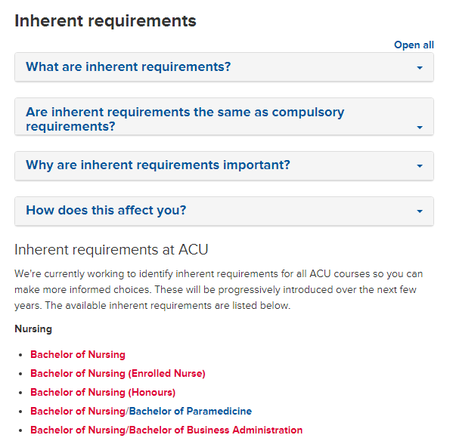

Slide 27
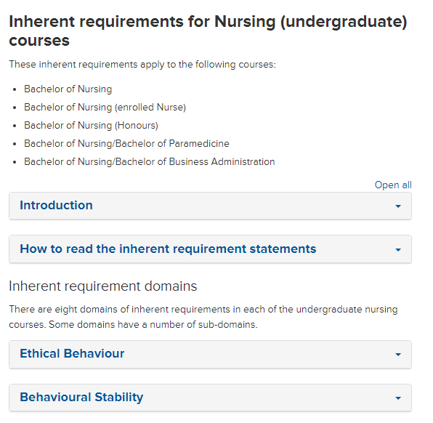

Slide 28
Evaluation
To determine the usefulness of the Inherent Requirements framework to FHS, Disability Services staff and students the following evaluation will occur:
Data will be collected during first semester.
Feedback from Disability Services and Academic Staff will be sought.
Selected Students will be interviewed.
Notes:
Data collected in sem 1 will consist of records maintained in disability services and analytics associated with web page

Slide 29
Resources
Information on web site:
http://www.acu.edu.au/study_at_acu/courses/inherent_requirements
FAQs access via web site
Disability Services Manager – Carolyn Toonen
IR Working party member – A/Professor Amanda Johnson
Notes:
Info on web site How to read IRs

Slide 30
UWS Courses with published IRs
Accounting courses Bachelor of Applied Leadership and Critical Thinking Bachelor of Community Welfare Bachelor of Criminal and Community Justice Education and Teaching courses Engineering courses Interpreting and Translation courses Language courses Law courses Medicine courses | Midwifery (undergraduate) course Nursing (undergraduate) courses Nursing and Midwifery (postgraduate) courses Occupational Therapy courses Bachelor of Paramedicine Physiotherapy courses Master of Psychology (Clinical Psychology) Bachelor of Social Work TESOL courses
A
Notes:
KP
Current Disciplines at UWS with uploaded IR’s:
Over 89 courses
Over 70 in development
Drafting commenced in the School of Health Sciences
School of Business staff have attended IR Workshops and drafting has commenced with potential for development of over 40 courses offered by SoB
School of Computing, Engineering and Mathematics have listed 22 courses that IR are required and we are coordinating their development
School of Social Sciences and Psychology staff have attended our IR Education Sessions and drafting their courses has commenced.
Bachelor of Policing draft
Bachelor of Applied Leadership Critical Thinking completed for upload
Bachelor of Design completed waiting for Dean approval
Art Therapy draft
Counselling draft
B. Psychology draft
Podiatry draft
International Studies Pathway courses draft
Criminology + Social Sciences
Pathways to Master Urban Management +Planning
Communication Arts

Slide 31
Institutional Adoption
University | Courses/Programs
Edith Cowan University | U/G Nursing U/G Midwifery
University of New England | U/G Nursing P/G Nursing (multiple) U/G Social Work UWS IR Web page
University of New South Wales | Master of Teaching Primary &Secondary
University of Technology, Sydney | U/G Nursing U/G Midwifery Key Terms Master of Teaching (Primary and Secondary) Master of Teaching (Birth- 5 Birth -12)
Murdoch University | U/G Nursing Key Terms
A
Notes:
UWS adopted IR’s , signed IP

Slide 32
University | Courses/Programs
Australian Catholic University | U/G Nursing U/G Midwifery U/G Paramedicine U/G Social Work Masters Psychology Key terms U/G and Masters Occupational Therapy U/G & P/G Physiotherapy
University of Southern Queensland | U/G & Masters Accountancy U/G Education Master of Teaching (Birth -5 Birth 12) Master of Teaching (Primary and Secondary) U/G Engineering U/G Law U/G & P/G Midwifery U/G & P/G Nursing Master of Psychology
A

Slide 33
University | Courses/Programs
The University of Newcastle | U/G Medicine U/G Nursing U/G Midwifery U/G & P/G Occupational Therapy U/G & P/G Physiotherapy
Avondale | U/G Nursing
Central Queensland University | U/G Nursing initial pilot
University of Tasmania | Framework U/G Education Master of Teaching (Birth -5 Birth 12) Master of Teaching (Primary and Secondary)
A

Slide 34
University | Courses/Programs
Macquarie University | Framework
Royal Melbourne Institute of Technology | Framework Key Terms U/G Nursing U/G Social Work U/G Education Masters of Teaching Primary & Secondary Master of Teaching (Birth -5 Birth 12) U/G Community Welfare U/G Engineering U/G Law
Southern Cross University | U/G Nursing with aim to roll UWS IRs/framework across all courses
A

Slide 35

Collaborations In Progress
International Universities
1
National Universities
16
Tafe
2
A

Slide 36
Scholarly Outputs
Journals Articles:
Johnson, A., Allan,T .,Goldsmith, M.,Phillips, K.,Dickson, C.,Azzopardi, T.,Hengstberger-Sims, C. Developing inherent requirements for undergraduate nursing students with disability: An Australian experience (for resubmission).
Azzopardi, T., Johnson, A., Phillips, K., Dickson, C., Hengstberger-Sims, C., Goldsmith, M. & Allan, T. (2014). Simulation as a learning strategy: Supporting undergraduate nursing students with disabilities. Journal of Clinical Nursing, 23(3-4), 402-409. doi: 10.1111/jocn.12049
Bialocerkowski, A., Johnson, A., Allan, T., Phillips, K. (2013). Promoting inclusion for student’s with disability – Physiotherapy inherent requirements. BMC Medical Education, 13:54 doi 1186/1472-6920- 13-54
Amanda

Slide 37
Scholarly Outputs
Book Chapter:
Allan, T., Johnson, A., Phillips, K., Azzopardi, T., Dickson, C., Goldsmith, M., & Hengstberger-Sims, C. (2013). Articulating course inherent requirements: Risk and response at the University of Western Sydney. In C. Jenkin (Ed) Ngā reo mō te tika: Voices for equity. pp. 138-168 http://www.adcet.edu.au/EdEquity/View.aspx?id=8643
Conference Presentations
International x3; National x5
Higher Research Degree Student in progress
OLT Grant unsuccessful in 2014
Amanda

Slide 38

Questions

Slide 39
References
Allan, T., Johnson, A., Phillips, K., Azzopardi, T., Dickson, C., Goldsmith, M., & Hengstberger-Sims, C. (2013). Articulating course inherent requirements: Risk and response at the University of Western Sydney. In C.Jenkin (Ed) Ngā reo mō te tika: Voices for equity. pp. 138-168 from http://www.adcet.edu.au/EdEquity/View.aspx?id=8643
Australian Government Department of Education, Employment and workplace Relations (2012), Report of the Review of Disability Standards for Education 2005.Retrieved July 28th, 2012, from https://education.gov.au/disability-standards-education
Australian Government Department of Industry, Innovation, Science, Research and Tertiary Education (2011), Student 2011 Full Year: Selected Higher Education Statistics. Retrieved December 12th, 2012, from http://www.innovation.gov.au/HigherEducation/HigherEducationStatistics/StatisticsPublications/Pages/Students.aspx
Australian Government Department of Industry, Innovation, Science, Research and Tertiary Education (2011), Student 2010 Full Year: Selected Higher Education Statistics. Retrieved December 12th, 2012, from http://www.innovation.gov.au/HigherEducation/HigherEducationStatistics/StatisticsPublications/Pages/Students.aspx
Australian Nursing and Midwifery Council. (2006). National competency standards for the Registered Nurse (4th ed.).Melbourne: Australian Health Practitioner Regulation Agency. Retrieved February 2, 2011, from http://www.nursingmidwiferyboard.gov.au/Codes-Guidelines-Statements/Codes-Guidelines.aspx

Slide 40
Australian Government Comlaw. (2010). Disability Discrimination Act No.135 of 1992 as amended. Canberra: Australian Government Office of Legislative Drafting and Publishing. Retrieved March 3, 2011, from http://www.comlaw.gov.au/Details/C2014C00013
Australian Government Comlaw. (2005). Disability Standards for Education Commonwealth of Australia. Canberra: Australian Government Office of Legislative Drafting and Publishing. Retrieved March 3, 2011, from http://www.comlaw.gov.au/Details/F2005L00767
Azzopardi, T., Johnson, A., Phillips, K., Dickson, C., Hengstberger-Sims, C., Goldsmith, M. & Allan, T. (2014). Simulation as a learning strategy: Supporting undergraduate nursing students with disabilities. Journal of Clinical Nursing, 23(3-4), 402-409. doi: 10.1111/jocn.12049
Bialocerkowski, A., Johnson, A., Allan, T., Phillips, K. (2013). Promoting inclusion for student’s with disability – Physiotherapy inherent requirements. BMC Medical Education, 13:54 doi 1186/1472-6920-13-54
Bradley, D., Noonan, P., Nugent, H. & Scales, B (2008) Review of Australian Higher Education: Final Report. Retrieved May 10, 2011, from http://www.industry.gov.au/highereducation/ResourcesAndPublications/ReviewOfAustralianHigherEducation/Pages/ReviewOfAustralianHigherEducationReport.aspx
Grace, S. & Gravestock, P (2009).Inclusion and diversity. Meeting the needs of all students. Routledge, New York.
Higher Education Statistics Agency [HESA]. (2000).Students in University 1998/1999- Reference Volume. Higher Education Statistics Agency, Cheltenham.

Slide 41
Johnson, A., Allan,T., Phillips,K., Azzopardi,T., Dickson,C., Goldsmith,M & Hengstberger-Sims, C. (2012). Inherent Requirements Resource Package , Inherent Requirements of Nursing Education ( IRoNE) University of Western Sydney School of Nursing & Midwifery and Student Equity & Disability Services.
Kerr, S. & Baker M (2013). Six practical principles for inclusive curriculum design. In Tynan, B., Willems, J. & James, R. (Eds.), Outlooks and opportunities in blended and distance learning (A volume in the Advances in Mobile and Distance Learning (AMDL) Book Series), pp. 74-88. Hershey, PA: Information Science Reference (an imprint of IGI Global).
Konur, O. (2002). Access to Nursing Education by Disabled Students: Rights and Duties of Nursing Programs. Nurse Education Today, 22(5), 364-374.
School of Nursing. (2006). Undergraduate Course Document. 4642 Bachelor of Nursing School of Nursing, University of Western Sydney.
University of Western Sydney. (2010). Award Courses and Unit Approval Policy. Retrieved December 12th from http://policies.uws.edu.au/view.current.php?id=00117
University of Western Sydney Inherent Requirements Working Party. (2010). Report by the Inherent Requirement Working Party. Presented to Academic Senate Education Committee, 7th June, University of Western Sydney.

