Slide 1
Student Evaluation of Learning and Teaching (SELT) Survey

Slide 2
Student Evaluation of Learning and Teaching (SELT)
SELT surveys are conducted online and each survey is for a particular unit.
SELT surveys can be accessed through LEO in the Evaluations-Tasks block (located under the right-hand side of the homepage), and through the link (URL) embedded in emails sent to your ACU student email account by Evaluations.LTC@acu.edu.au
Your feedback on unit(s) is important for quality assurance and the improvement of learning and teaching in ACU.
Your feedback through SELT is also valuable for the particular teacher’s career progression.
SELT survey reports are made available to staff only after the release of examination results. Your feedback will be reported anonymously.

Slide 3
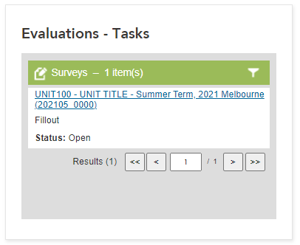
You can access the SELT ‘Evaluation-Tasks’ block through LEO

Slide 4
When completing the survey…
You need to select your answers and move onto the next section. Click the "NEXT" button at the bottom of screen.
Please remember to click the “SUBMIT” button after you complete each survey.
If you cannot complete the survey in one session, you can save by clicking the “SAVE” button.
To resume a previously saved survey, or if your session times out prior to submitting, please use the email link or LEO access.

Slide 5
We really appreciate your contribution and look forward to receiving your feedback.
If you experience any difficulty in accessing or completing the surveys, please email
Evaluations.LTC@acu.edu.au
Thank you!

